Slide 1
LINKS How to send in your LINKS cash donations.

Slide 2
How should our church's LINKS cash donation be handled?
2 – ways
Snail Mail
OR
Electronically

Slide 3
Please do not send money directly to the missionary.
It may never reach them, and money is sometimes difficult to exchange in some world areas.
Note the missionary's name on the check, as well as what it's for (cash donation, birthday, Christmas, anniversary, etc.).
Money cannot be credited properly without the missionary's name (or church name).

Slide 4
Snail Mail
Make the check payable to:
"General Treasurer"
Mail it to:
Global Treasury Services
Church of the Nazarene P.O. Box 843116 Kansas City, MO 64184-3116

Slide 5
Electronically “Funding the Mission”
www:fundingthemission.org
Your local treasurer is probably already using “Funding the Mission”.
If not they will need to set up an account by contacting your district office or email stewardship@nazarene.org or
call 800-544-8413.

Slide 6
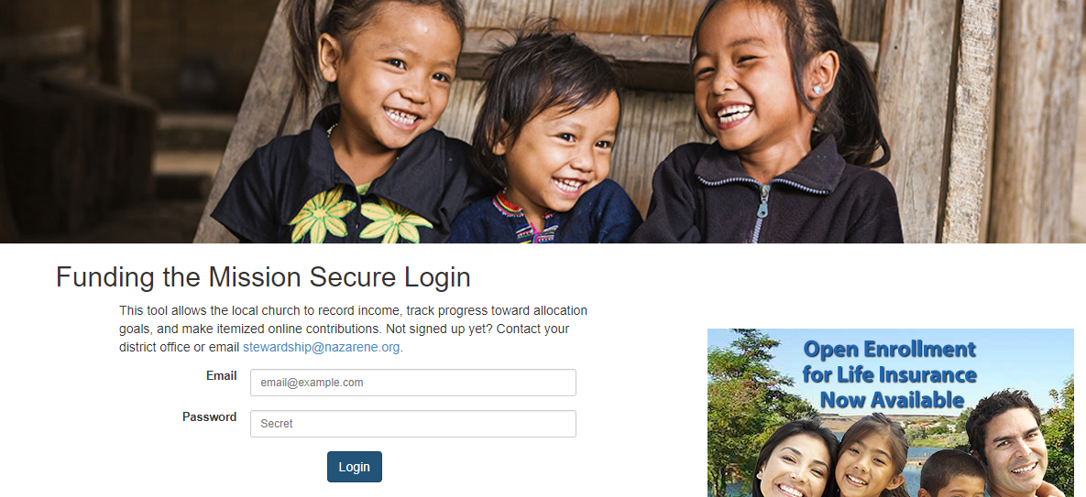
www:fundingthemission.org Login screen Enter your email address and password

Slide 7
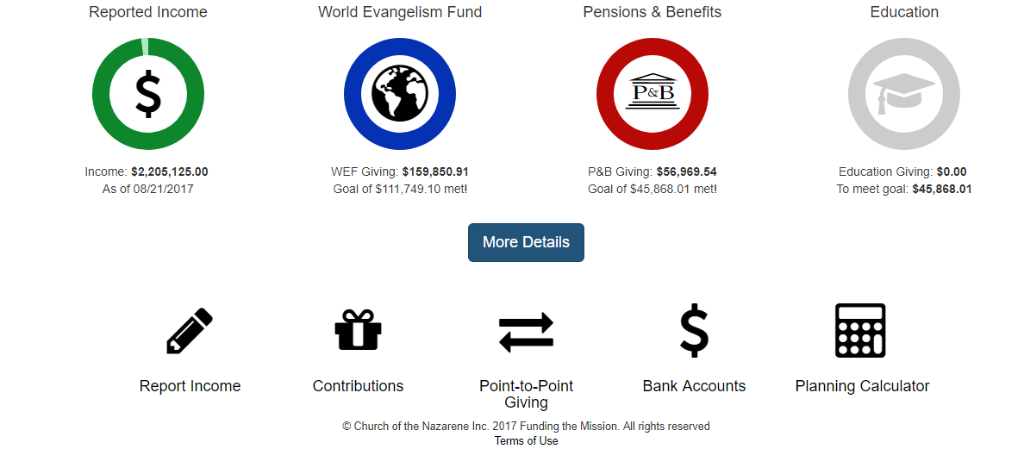
Click on contributions (lower left side)

Slide 8
Click on “Make a Contribution”

Slide 9
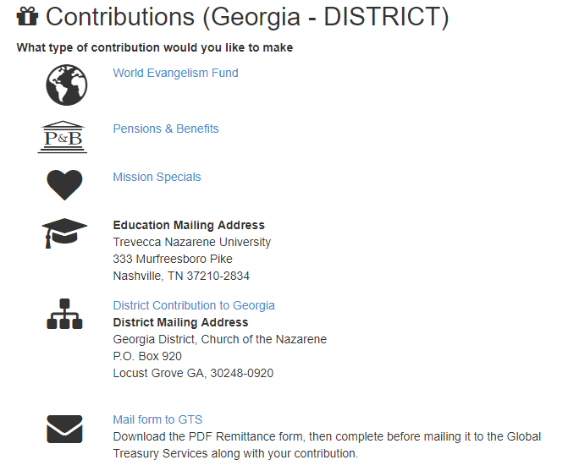
Click on “Mission Specials”

Slide 10
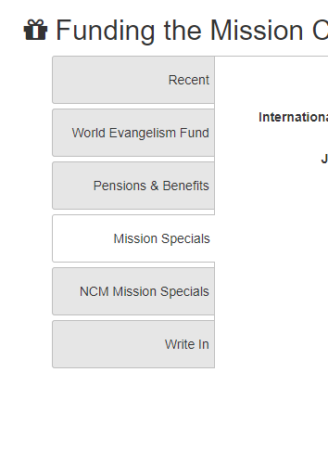
Click on “Write In”

Slide 11
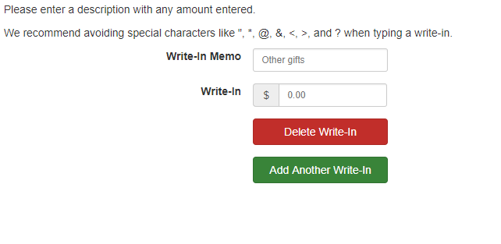
Write-in Memo: be specific – LINKS - name, amount, and what it’s for - love gift, birthday, Christmas, etc.
Write-in $: enter total amount

Slide 12
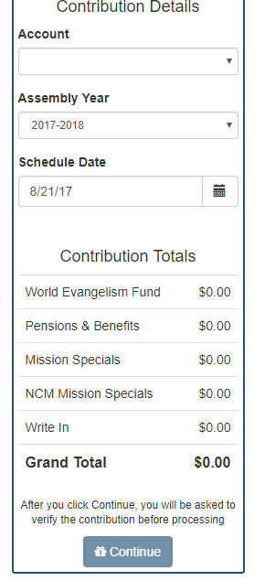
Account information
Make sure it is the correct year being accounted in
Click Continue

Slide 13
For more information on LINKS
http://nmi.nazarene.org/10012/story.html
If you have an “employee” serving in CAA, you may still send in your donation the same way. “FTM” is a secure site. But please still take precautions using first names.

